Slide 1


DATA SCIENCE
with
SMALL TEAMS
Drew Fustin
PhD, Physics
Lead Data Scientist
drewfustin@gmail.com | 7.5.2016 | PyData Chicago

Slide 2

DATA SCIENCE
with
SMALL TEAMS
Or: Lots of Advice I Need to Hear and Apply Myself
drewfustin@gmail.com | 7.5.2016 | PyData Chicago

Slide 3
DATA SCIENCE
according to Jeremy Stanley, VP of Data Science at Instacart
DECISION SCIENCE
use data to analyze business metrics — such as growth, engagement, profitability drivers, and user feedback — to inform strategy and key business decisions.
DATA PRODUCTS
use data and engineering to improve product performance, typically in the form of better search results, recommendations, and automated decisions.
drewfustin@gmail.com | 7.5.2016 | PyData Chicago

Slide 4
DATA SCIENCE
according to Jeremy Stanley, VP of Data Science at Instacart
“While decision science and data products call for some of the same skills, it’s rare for data scientists to excel at both. Decision science depends on business and product sense, systems thinking, and strong communication skills. Data products require machine learning knowledge and production-level engineering skills. If you have a small data science team, you may need to find the rare superstars who can do both. But you’ll benefit from specialization as you scale your team.”
Doing Data Science Right — Your Most Common Questions Answered
Jeremy Stanley and Daniel Tunkelang
http://firstround.com/review/doing-data-science-right-your-most-common-questions-answered/
drewfustin@gmail.com | 7.5.2016 | PyData Chicago

Slide 5
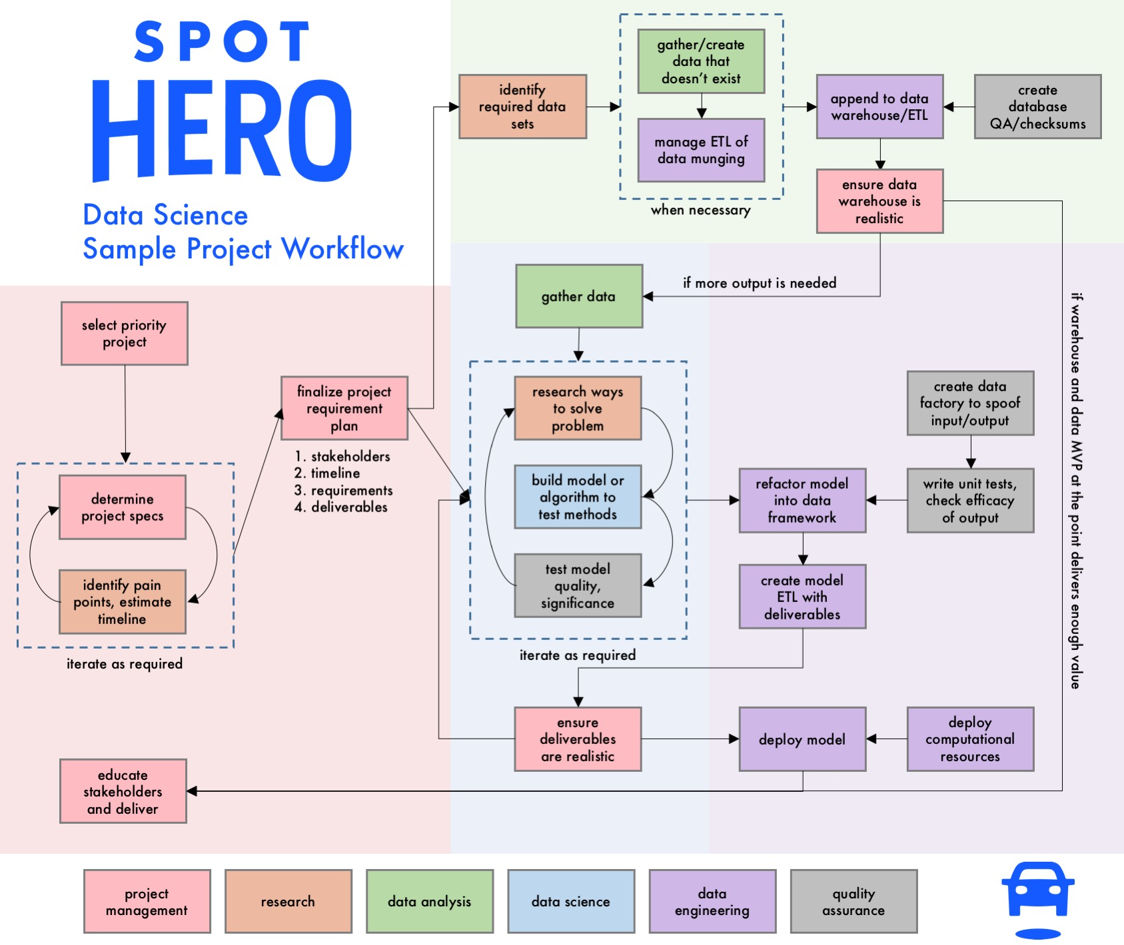
DATA
SCIENCE
IS
COMPLICATED
drewfustin@gmail.com | 7.5.2016 | PyData Chicago

Slide 6
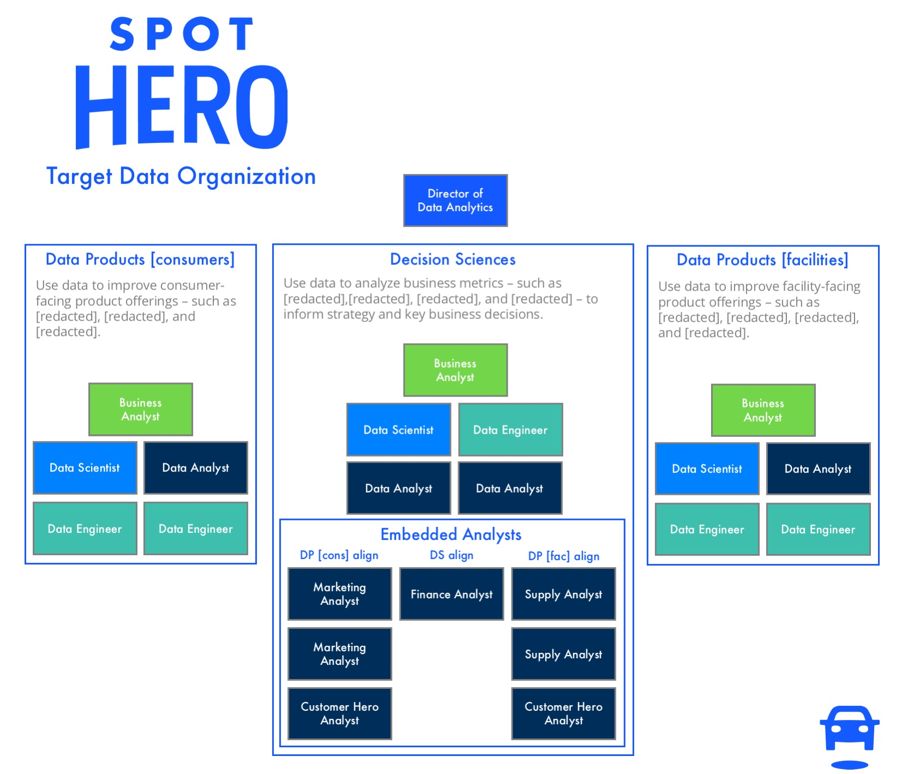
DATA
SCIENCE
IS
EASIEST WITH A
TEAM
drewfustin@gmail.com | 7.5.2016 | PyData Chicago

Slide 7
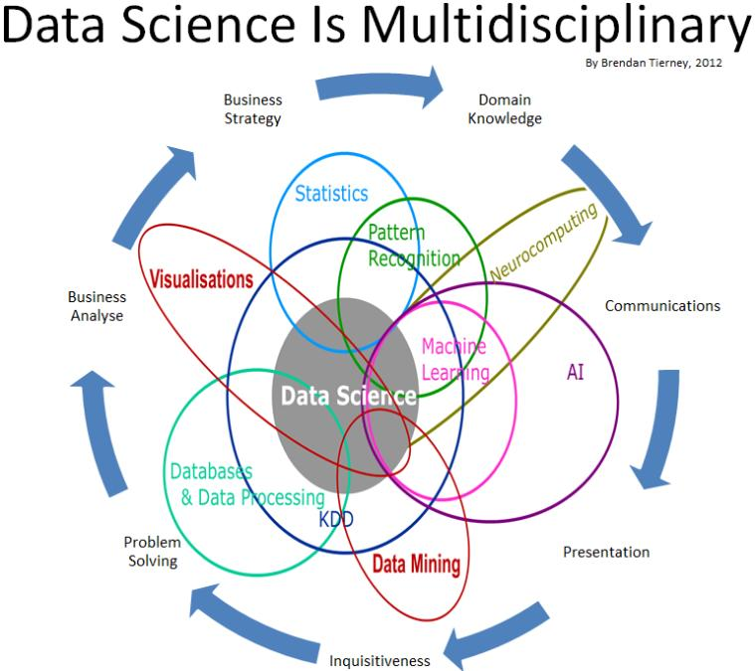
DATA
SCIENCE
IS
EASIEST WITH A
TEAM
drewfustin@gmail.com | 7.5.2016 | PyData Chicago

Slide 8

DATA
SCIENCE
IS
EASIEST WITH A
TEAM
drewfustin@gmail.com | 7.5.2016 | PyData Chicago

Slide 9
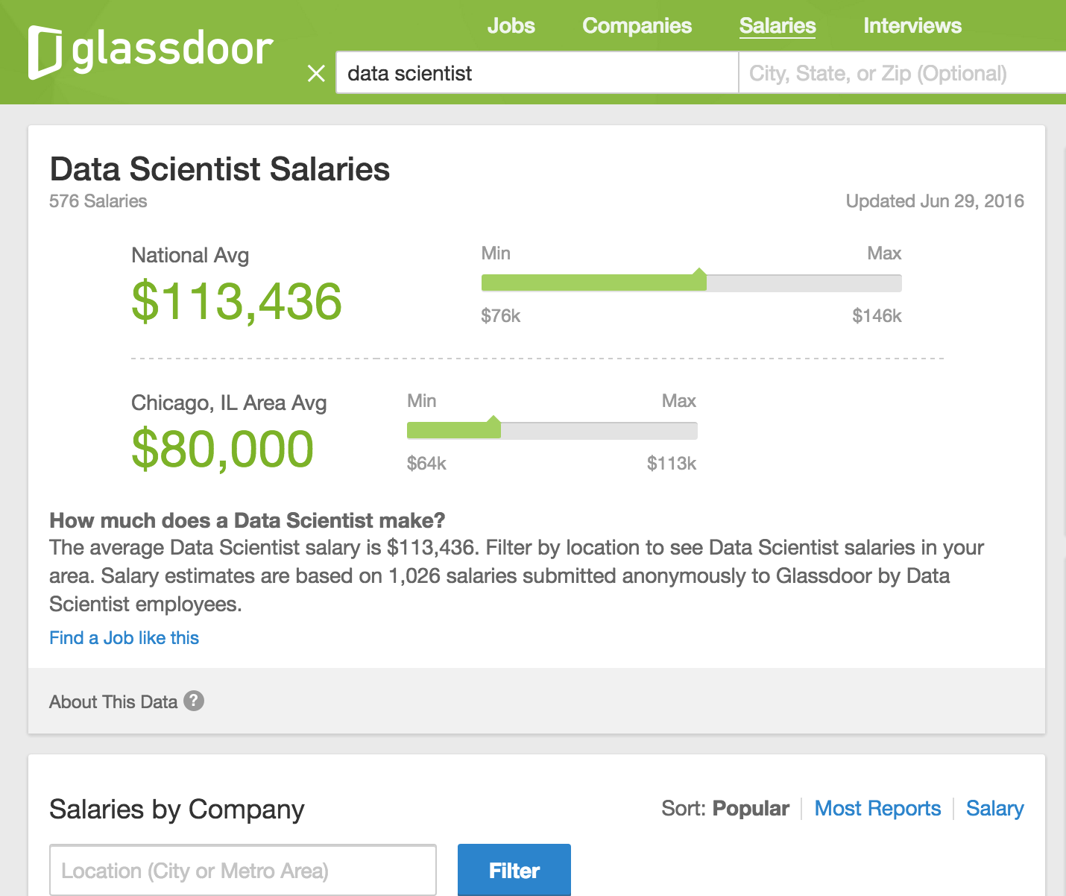
DATA
SCIENCE
IS
EXPENSIVE
drewfustin@gmail.com | 7.5.2016 | PyData Chicago

Slide 10
DATA SCIENCE
according to Drew Conway, CEO of Alluvium
NOT ALL
VENN DIAGRAMS ARE USELESS
Hacking Skills
Machine Learning
Math & Statistics Knowledge
Data Science
Danger Zone!
Traditional Research
Substantive Expertise
drewfustin@gmail.com | 7.5.2016 | PyData Chicago

Slide 11
DATA SCIENCE
according to Drew Conway, CEO of Alluvium
SMALL TEAM?
YOU CAN’T JUST BE A DATA SCIENTIST
You must be your own Product Manager and User Experience Researcher
++
Hacking Skills
Machine Learning
Math & Statistics Knowledge
Data Science
Danger Zone!
Traditional Research
Substantive Expertise
drewfustin@gmail.com | 7.5.2016 | PyData Chicago

Slide 12
DATA SCIENCE
according to Drew Conway, CEO of Alluvium
SMALL TEAM?
YOU CAN’T JUST BE A DATA SCIENTIST
You must be your own Product Manager and User Experience Researcher
++
Hacking Skills
Machine Learning
Math & Statistics Knowledge
Data Science
Danger Zone!
Traditional Research
Substantive Expertise
Sorry, but it’s probably wise to spend ~20% of your time OVER-COMMUNICATING with stakeholders
and UNDERSTANDING their needs
drewfustin@gmail.com | 7.5.2016 | PyData Chicago

Slide 13
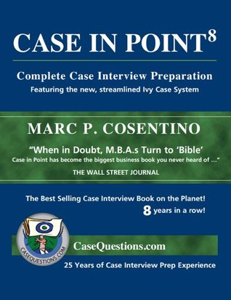
PM + UX
FROM ACADEMIA?
Learn to speak
strategy and business
GROSS MARGIN, KPIs, LTV, CAC, ATTRIBUTION, ROI, RETENTION, ATTRITION, MONTHS-TO-PAYBACK, blah blah blah
drewfustin@gmail.com | 7.5.2016 | PyData Chicago

Slide 14
PM + UX
according to Arthur Geoffrion, UCLA Anderson School of Management
RESERVE THE RIGHT
OF PROBLEM FORMULATION
Maxims for Modelers
Arthur Geoffrion
http://www.anderson.ucla.edu/faculty/art.geoffrion/home/docs/Gudmdlg2.htm
drewfustin@gmail.com | 7.5.2016 | PyData Chicago

Slide 15
PM + UX
according to Arthur Geoffrion, UCLA Anderson School of Management
DEVELOP A CLEAR CHARTER
AND PROJECT PLAN
Maxims for Modelers
Arthur Geoffrion
http://www.anderson.ucla.edu/faculty/art.geoffrion/home/docs/Gudmdlg2.htm
drewfustin@gmail.com | 7.5.2016 | PyData Chicago

Slide 16
PM + UX
according to Arthur Geoffrion, UCLA Anderson School of Management
FIND A HIGH-LEVEL CHAMPION
Maxims for Modelers
Arthur Geoffrion
http://www.anderson.ucla.edu/faculty/art.geoffrion/home/docs/Gudmdlg2.htm
drewfustin@gmail.com | 7.5.2016 | PyData Chicago

Slide 17
PM + UX
according to Arthur Geoffrion, UCLA Anderson School of Management
ESTABLISH PERSONAL CREDIBILITY
AND PRODUCE RESULTS EARLY
Maxims for Modelers
Arthur Geoffrion
http://www.anderson.ucla.edu/faculty/art.geoffrion/home/docs/Gudmdlg2.htm
drewfustin@gmail.com | 7.5.2016 | PyData Chicago

Slide 18
PM + UX
according to Arthur Geoffrion, UCLA Anderson School of Management
INVOLVE THE STAKEHOLDER
AND FUTURE USERS AT ALL STAGES
Maxims for Modelers
Arthur Geoffrion
http://www.anderson.ucla.edu/faculty/art.geoffrion/home/docs/Gudmdlg2.htm
drewfustin@gmail.com | 7.5.2016 | PyData Chicago

Slide 19
PM + UX
according to Arthur Geoffrion, UCLA Anderson School of Management
COMMUNICATE OFTEN AND WELL
Maxims for Modelers
Arthur Geoffrion
http://www.anderson.ucla.edu/faculty/art.geoffrion/home/docs/Gudmdlg2.htm
drewfustin@gmail.com | 7.5.2016 | PyData Chicago

Slide 20
OUR GOAL
FOCUS or EXPAND
when it works to stay small
provide a customer solution that is usually similar each time,
and iteratively add features to this solution so the product expands over time
when scale is needed to be impactful
get more team members that complement your own skills, eventually growing a team to allow for increased scope that includes both Decision Science and Data Products
drewfustin@gmail.com | 7.5.2016 | PyData Chicago

Slide 21
FOCUS
e.g. SaaS Data Product or Marketing Optimization Decision Science
CRITICAL: UX FEEDBACK LOOP Understand (and help drive) expectations
and deliver each project excellently and completely.
drewfustin@gmail.com | 7.5.2016 | PyData Chicago

Slide 22
FOCUS
e.g. SaaS Data Product or Marketing Optimization Decision Science
UNIT TEST ALL THE THINGS While unit tests are always important,
when a product is built iteratively, they are necessary.
Have data factories to spoof typical/edge case data.
drewfustin@gmail.com | 7.5.2016 | PyData Chicago

Slide 23
FOCUS
e.g. SaaS Data Product or Marketing Optimization Decision Science
DOUBLE THE DOCUMENTATION Explain the process technically (for future you)
and accurately but simply (for the consumer).
drewfustin@gmail.com | 7.5.2016 | PyData Chicago

Slide 24
EXPAND
e.g. Recommendation Engines + Attribution Models + Routing Algorithms + …
CRITICAL: QUICK TO “GOOD ENOUGH” You need to scale the team to be effective,
so produce small, easy wins to earn favor and budget.
Think Pareto’s principle: 80% quality at 20% time cost.
drewfustin@gmail.com | 7.5.2016 | PyData Chicago

Slide 25
EXPAND
e.g. Recommendation Engines + Attribution Models + Routing Algorithms + …
GET DATA MVPs INTO PRODUCTION Many Data Products require lots of user data,
so get an MVP out to start, and wait to improve.
drewfustin@gmail.com | 7.5.2016 | PyData Chicago

Slide 26
EXPAND
e.g. Recommendation Engines + Attribution Models + Routing Algorithms + …
BE AN EXCELLENT DATA ENGINEER Projects are often standalone,
so have a reliable ETL process to reduce upkeep.
Upkeep time budget will increase over time.
drewfustin@gmail.com | 7.5.2016 | PyData Chicago

Slide 27
DATA SCIENCE
according to Drew Conway, CEO of Alluvium
SMALL TEAM?
YOU CAN’T JUST BE A DATA SCIENTIST
You must be your own Product Manager and User Experience Researcher
++
Hacking Skills
Machine Learning
Math & Statistics Knowledge
Data Science
Danger Zone!
Traditional Research
Substantive Expertise
drewfustin@gmail.com | 7.5.2016 | PyData Chicago

Slide 28
DATA SCIENCE
according to Drew Conway, CEO of Alluvium
SMALL TEAM?
YOU CAN’T JUST BE A DATA SCIENTIST
You must be your own Product Manager and User Experience Researcher
and Data Engineer and QA Test Engineer
++++
Hacking Skills
Machine Learning
Math & Statistics Knowledge
Data Science
Danger Zone!
Traditional Research
Substantive Expertise
drewfustin@gmail.com | 7.5.2016 | PyData Chicago

Slide 29
DATA SCIENCE
according to Drew Conway, CEO of Alluvium
SMALL TEAM?
YOU CAN’T JUST BE A DATA SCIENTIST
You must be your own Product Manager and User Experience Researcher
and Data Engineer and QA Test Engineer
++++
+
+
Math & Statistics Knowledge
+
Hacking Skills
Machine Learning
+
+
Data Science
+
+
Danger Zone!
Traditional Research
Substantive Expertise
drewfustin@gmail.com | 7.5.2016 | PyData Chicago

Slide 30

AN ASIDE
drewfustin@gmail.com | 7.5.2016 | PyData Chicago

Slide 31
AN ASIDE
Lest you feel overwhelmed:
You don’t have to be great at all of this.
drewfustin@gmail.com | 7.5.2016 | PyData Chicago

Slide 32
AN ASIDE
Lest you feel overwhelmed:
You don’t have to be great at all of this.
The beauty of being part of a small team is that
what you contribute is probably going to be
significantly better than what already exists.
drewfustin@gmail.com | 7.5.2016 | PyData Chicago

Slide 33
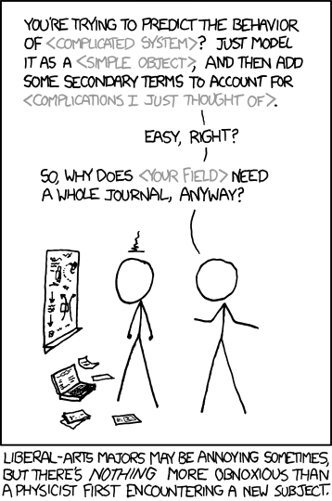
ALSO… NO.
DON’T BE A PHYSICIST.
PEOPLE WHO ACTUALLY DO THESE JOBS?
THEY’RE BETTER THAN YOU AT DOING THEM.
https://xkcd.com/793/
drewfustin@gmail.com | 7.5.2016 | PyData Chicago

Slide 34
EXAMPLE
MY EVERYDAY TOOLKIT
drewfustin@gmail.com | 7.5.2016 | PyData Chicago

Slide 35


EXAMPLE
MY EVERYDAY TOOLKIT
PYTHON 3 + ANACONDA
drewfustin@gmail.com | 7.5.2016 | PyData Chicago

Slide 36


EXAMPLE
MY EVERYDAY TOOLKIT
PYTHON 3 + ANACONDA
+ JUPYTER + PLOTLY
drewfustin@gmail.com | 7.5.2016 | PyData Chicago

Slide 37
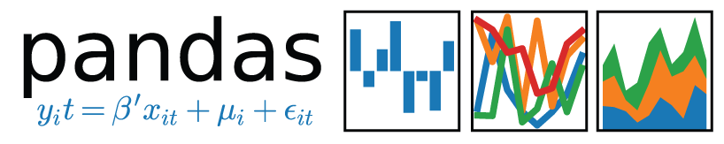
EXAMPLE
MY EVERYDAY TOOLKIT
PYTHON 3 + ANACONDA
+ JUPYTER + PLOTLY
+ PANDAS
drewfustin@gmail.com | 7.5.2016 | PyData Chicago

Slide 38

EXAMPLE
MARKETING OPTIMIZATION AT SPOTHERO
DATA COLLECTION
Transaction data in AWS Redshift
drewfustin@gmail.com | 7.5.2016 | PyData Chicago

Slide 39






EXAMPLE
MARKETING OPTIMIZATION AT SPOTHERO
DATA COLLECTION
Transaction data in AWS Redshift
User acquisition data from Google Analytics, AppsFlyer, Branch, Typeform, etc
to Redshift via in-house/external ETL or webhooks + AWS S3 + AWS Lambda
drewfustin@gmail.com | 7.5.2016 | PyData Chicago

Slide 40

EXAMPLE
MARKETING OPTIMIZATION AT SPOTHERO
DATA QUERYING
Query customer data using Psycopg2 against Redshift into pandas dataframes
drewfustin@gmail.com | 7.5.2016 | PyData Chicago

Slide 41
EXAMPLE
MARKETING OPTIMIZATION AT SPOTHERO
CHANNEL ATTRIBUTION
Develop an algorithm in pandas to assign for each customer the likelihood that
a particular marketing channel was used in their acquisition
drewfustin@gmail.com | 7.5.2016 | PyData Chicago

Slide 42

EXAMPLE
MARKETING OPTIMIZATION AT SPOTHERO
CHANNEL ATTRIBUTION
Develop an algorithm in pandas to assign for each customer the likelihood that
a particular marketing channel was used in their acquisition
Data factories spoof customer data for pytest unit tests of acquisition model
drewfustin@gmail.com | 7.5.2016 | PyData Chicago

Slide 43
EXAMPLE
MARKETING OPTIMIZATION AT SPOTHERO
COHORT VALUE FORECASTS
Use historical rental trends to predict future revenue in pandas
drewfustin@gmail.com | 7.5.2016 | PyData Chicago

Slide 44


EXAMPLE
MARKETING OPTIMIZATION AT SPOTHERO
COHORT VALUE FORECASTS
Use historical rental trends to predict future revenue in pandas
Regression forecasting + attrition modeling + backtesting in scikit-learn
ARIMA forecasting + tests for autocorrelation, stationarity, etc in statsmodels
drewfustin@gmail.com | 7.5.2016 | PyData Chicago

Slide 45
EXAMPLE
MARKETING OPTIMIZATION AT SPOTHERO
MARKETING SPEND
Move marketing spend csv to Redshift via S3 using Boto 3 + Psycopg2
drewfustin@gmail.com | 7.5.2016 | PyData Chicago

Slide 46
EXAMPLE
MARKETING OPTIMIZATION AT SPOTHERO
MARKETING SPEND
Move marketing spend csv to Redshift via S3 using Boto 3 + Psycopg2
Assign spend to customers (and cohorts) with a divvying algorithm
applied using (you guessed it) pandas
drewfustin@gmail.com | 7.5.2016 | PyData Chicago

Slide 47
EXAMPLE
MARKETING OPTIMIZATION AT SPOTHERO
CAC/LTV RATIO OPTIMIZATION
All customer acquisition costs (CAC) and lifetime value (LTV) forecasts are written to a data store in Redshift
drewfustin@gmail.com | 7.5.2016 | PyData Chicago

Slide 48

EXAMPLE
MARKETING OPTIMIZATION AT SPOTHERO
CAC/LTV RATIO OPTIMIZATION
All customer acquisition costs (CAC) and lifetime value (LTV) forecasts are written to a data store in Redshift
Marketing analysts use this data in the Looker BI tool to find efficient channels
drewfustin@gmail.com | 7.5.2016 | PyData Chicago

Slide 49


EXAMPLE
MARKETING OPTIMIZATION AT SPOTHERO
ETL PROCESS
Task dependencies on each branch of this process are handled by Luigi
on an AWS EC2 instance
drewfustin@gmail.com | 7.5.2016 | PyData Chicago

Slide 50
REMINDER:
drewfustin@gmail.com | 7.5.2016 | PyData Chicago

Slide 51
REMINDER:
DATA
SCIENCE
IS
COMPLICATED
drewfustin@gmail.com | 7.5.2016 | PyData Chicago

Slide 52
REMINDER:
DATA
SCIENCE
IS
COMPLICATED
TRY YOUR BEST TO BE YOUR OWN:
DATA SCIENTIST
DATA ENGINEER
QA TEST ENGINEER
PROJECT MANAGER
UX RESEARCHER
drewfustin@gmail.com | 7.5.2016 | PyData Chicago

Slide 53
REMINDER:
DATA
SCIENCE
IS
COMPLICATED
TRY YOUR BEST TO BE YOUR OWN:
DATA SCIENTIST
DATA ENGINEER
QA TEST ENGINEER
PROJECT MANAGER
UX RESEARCHER
¯\_(ツ)_/¯
drewfustin@gmail.com | 7.5.2016 | PyData Chicago

Slide 54
DATA SCIENCE
with
SMALL TEAMS
“While decision science and data products call for some of the same skills, it’s rare for data scientists to excel at both. Decision science depends on business and product sense, systems thinking, and strong communication skills. Data products require machine learning knowledge and production-level engineering skills. If you have a small data science team, you may need to find the rare superstars who can do both. But you’ll benefit from specialization as you scale your team.”
Jeremy Stanley and Daniel Tunkelang
drewfustin@gmail.com | 7.5.2016 | PyData Chicago

Slide 55
FURTHER READING
Doing Data Science Right — Your Most Common Questions Answered [Jeremy Stanley and Daniel Tunkelang]
http://firstround.com/review/doing-data-science-right-your-most-common-questions-answered/
Maxims for Modelers [Arthur Geoffrion]
http://www.anderson.ucla.edu/faculty/art.geoffrion/home/docs/Gudmdlg2.htm
Highly Effective Data Science Teams [Drew Harry]
https://medium.com/mit-media-lab/highly-effective-data-science-teams-e90bb13bb709
Data Engineering Architecture at Simple [Rob Story]
https://github.com/wrobstory/DataEngArchSimple/blob/master/2016_03_29_SimpleDataArch_with_notes.pdf
Data Science Team-Building and Optimization (talk) [Jeremy Stanley]
https://www.youtube.com/watch?v=CqQyrkEvh_8
drewfustin@gmail.com | 7.5.2016 | PyData Chicago

